Slide 1

CILogon
Federated Access to US CyberInfrastructure
Jim Basney jbasney@ncsa.uiuc.edu
This material is based upon work supported by the National Science Foundation under grant number 0943633. Any opinions, findings, and conclusions or recommendations expressed in this material are those of the author(s) and do not necessarily reflect the views of the National Science Foundation.
Notes:
Presented at the TERENA Networking Conference, May 22 2012. https://tnc2012.terena.org/

Slide 2
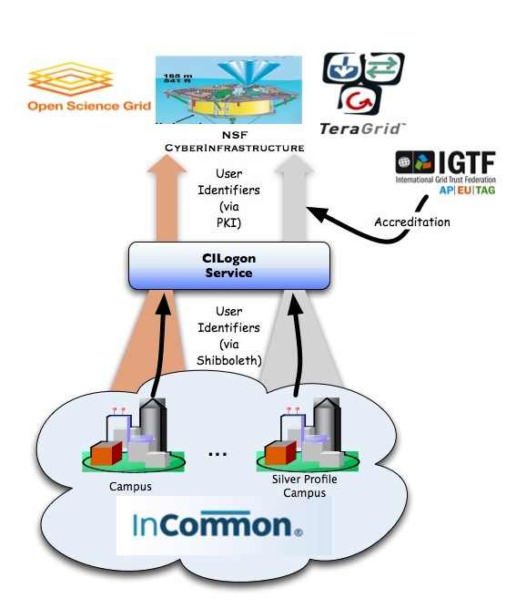
CILogon Project Goal
Enable campus logon to CyberInfrastructure (CI)
Use researchers’ existing security credentials at their home institution
Ease credential management for researchers and CI providers

Slide 3
Why certificates?
Command-line apps, non-web apps
Multi-stage, unattended batch workflows
Significant worldwide CI investment in PKI
Software, operations, standards, etc.

Slide 4
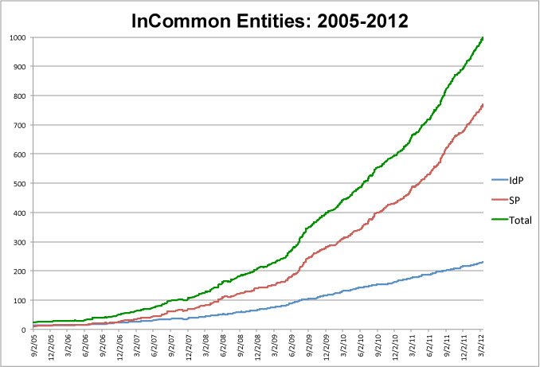
InCommon is the federation for U.S. research and education, providing higher education and their commercial and non-profit partners with a common trust framework for access to online resources.

Slide 5
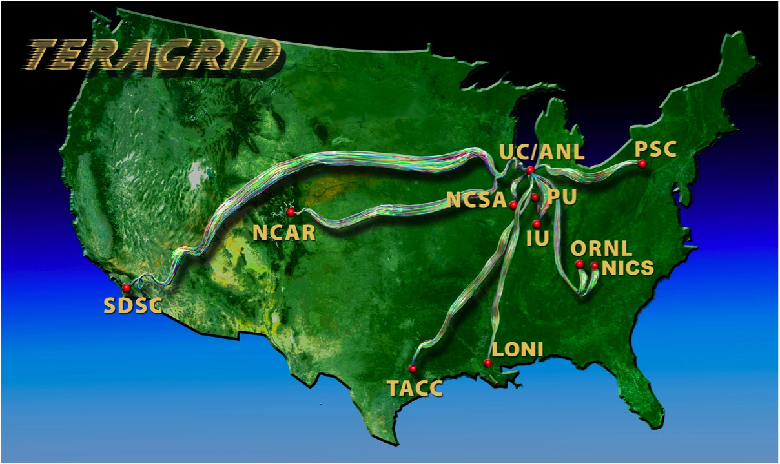
Prior Work: go.teragrid.org
Campus login to TeraGrid
35 campus IdPs
Relied on TeraGrid identity vetting
In production since September 2009
1000+ certificates issued to 65+ users
IGTF accredited
IDtrust 2010 paper: “Federated Login to TeraGrid” (http://middleware.internet2.edu/idtrust/2010/)
Notes:
The NSF-funded TeraGrid combined leadership class resources at eleven partner sites.
TeraGrid served over 4,500 researchers from over 300 US campuses.
ID vetting by peer review (like PRACE).

Slide 6
Account Linking
(one-time only)
Notes:
On the first login only, the researcher also logs in to TeraGrid to link the campus and TeraGrid identities (on the left).
The researcher can later delete account links via the web app (on the right).

Slide 7
CILogon Service (https://cilogon.org)
No TeraGrid account required
Supports InCommon and OpenID authentication
Delivers certificates to desktop, browser, and portals
Available certificate lifetimes: from 1 hour to 13 months
Supports close integration with CI projects
Available now!
FAQ: www.cilogon.org/faq

Slide 8
CILogon Portal Delegation
Grid Portals and Science Gateways provide web interfaces to CI
Portals/Gateways need certificates to access CI on researchers’ behalf
CILogon Delegation Service allows researchers to approve certificate issuance to portals (via OAuth)
www.cilogon.org/portal-delegation
Web Browser
authenticate & approve
access
CILogon
Portal
request certificate
access
CI

Slide 9
Integration Example: OOI

Slide 10


Slide 14


Slide 16
More Integration Examples

Slide 17
Challenges
Level of Assurance
Non-Browser Apps
IdP-SP On-Boarding
User Catch-All IdPs

Slide 18


Levels of Assurance
LOA requirements differ across scientific collaborations
2-factor authentication
IGTF accreditation
Open access with usage statistics
CILogon LOA options:
InCommon Silver: US Gov’t ICAM Level 2
OpenID OIX: US Gov’t ICAM Level 1
InCommon “Basic”

Slide 19
CILogon and IGTF
CILogon CA operations, key management, and certificate profiles meet IGTF standards
Issue: subscriber ID vetting & authentication
Goal: rely on campuses for this
Need minimum standards for campus practices
Approach: rely on InCommon Identity Assurance
Status:
CILogon Silver CA accredited October 2010
Now waiting for InCommon Silver campuses…
CILogon Basic & OpenID CAs operating w/o IGTF accreditation

Slide 20
Support for Non-Browser Apps
Option #1:
Use browser-based authentication (SAML, OpenID)
Get URL for certificate download (wget/curl)
Or use Java Web Start, etc.
Use certificate for non-browser authentication
Unfortunately still requires a browser
Option #2
Use SAML Enhanced Client or Proxy (ECP) authentication outside the browser to download certificate
ECP adoption by InCommon campuses beginning
Successfully tested with U Washington, U Chicago, LIGO, LTER, and ProtectNetwork
For more info: http://www.cilogon.org/ecp

Slide 21
ECP Example
$ curl -sSO https://cilogon.org/ecp.pl
$ perl ecp.pl --get cert -c create -k userkey.pem -o usercert.pem -t 12
Select an Identity Provider (IdP):
1> LTER Network
2> ProtectNetwork
3> University of Chicago
4> University of Washington
5> Specify the URL of another IdP
Choose [2]: 2
Enter a username for the Identity Provider: jbasney
Enter a password for the Identity Provider: ************
$ grid-proxy-init -cert usercert.pem -key userkey.pem -hours 4
Your identity: /DC=org/DC=cilogon/C=US/O=ProtectNetwork/CN=Jim Basney A685
Creating proxy ............................ Done
$ gsissh citest.example.edu
[jbasney@citest ~]$

Slide 22
SP On-Boarding
Goal: Enable successful use of SPs by users from many IdPs
Particularly difficult for “no contract” SPs (“user-driven” SPs)
Challenge: Attribute release
Technical solutions: user consent, attribute requirements in metadata, IdP filtering
Policy: privacy, FERPA, SP trust
Policies differ for students versus faculty/staff
Scaling: attribute bundles, default release policies

Slide 23
SP On-Boarding
Notes:
One method of SP on-boarding.

Slide 24
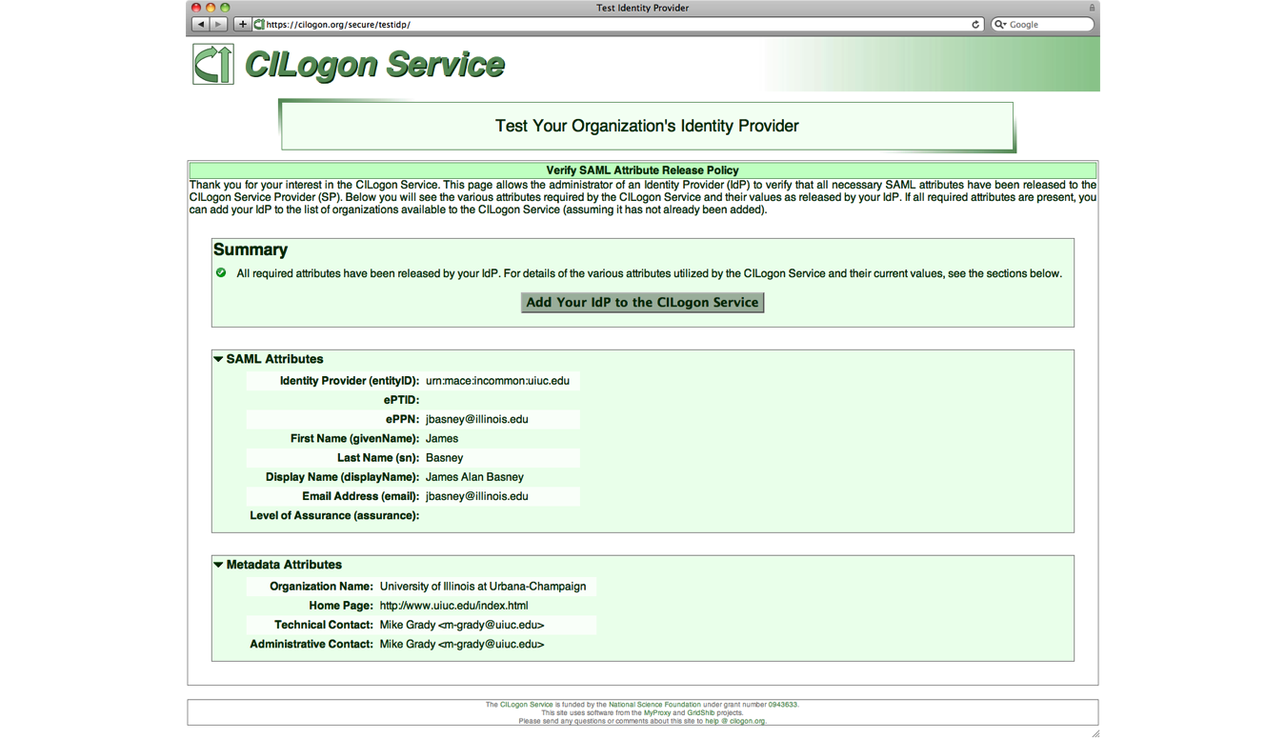
Notes:
Our method of SP on-boarding. Shows the attributes we need.

Slide 25
User Catch-All
Handling users w/o institutional logins
Home institution not (yet) in InCommon federation
Home institution not (yet) on-boarded w/ SP
go.teragrid.org
TeraGrid username/password
cilogon.org
“Request a New Organization” page
OpenID (Google, PayPal, VeriSign)
ProtectNetwork
Project logins (LTER, LIGO, …)

Slide 26
CILogon: Lessons Learned
InCommon today supports browser SSO
SAML->X.509 bridges are common for non-web apps (CILogon, TERENA Certificate Service, etc.)
SAML ECP adopted by ~5 InCommon IdPs so far (http://www.cilogon.org/ecp)
Attribute release is a major challenge today for SPs that want to support many IdPs
New InCommon effort to address this challenge: https://spaces.internet2.edu/display/InCCollaborate/Research+and+Scholarship+Category
Google OpenID is a popular “catch-all” IdP
US ICAM LOA 1 certified (http://openidentityexchange.org/certified-providers)

Slide 27
References
A Roadmap for Using NSF CyberInfrastructure with InCommon (http://www.incommon.org/nsfroadmap)
An Analysis of the Benefits and Risks to LIGO When Participating in Identity Federations (http://www.google.com/search?q=LIGOIdentityFederationRiskAnalysis.pdf)
Federated Security Incident Response (https://spaces.internet2.edu/x/8o6KAQ)

Slide 28
Thanks
For more information:
www.cilogon.org
info@cilogon.org

